Slide 1
REST Web Service with Spring Boot

Slide 2
Web Service vs API
Web Service can be an application, data source, or platform that is accessible via Internet with web protocol HTTP(s).
WS help to communicate between different software applications disregard to programming languages, environment or devices
Access via Internet, with web protocol HTTP(s)
Popular data format in JSON, XML, ….
Help to develop independent system
2 common types are SOAP & REST

Slide 3
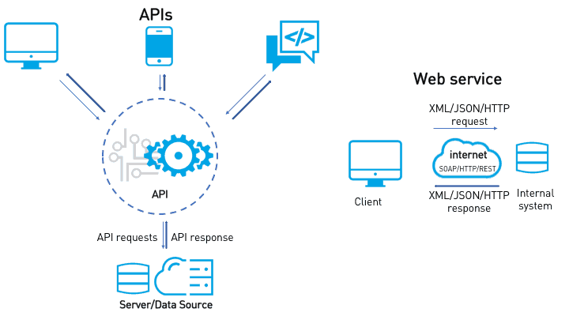
Web Service vs API

Slide 4
Web Service vs API
Web Service vs Web Application:
Web Application is designed for end-users
Web Service is designed to communicate between different applications or platforms
API: a set of functions or commands
is provided by Web Service
to transfer data between applications or platforms via request & response

Slide 5
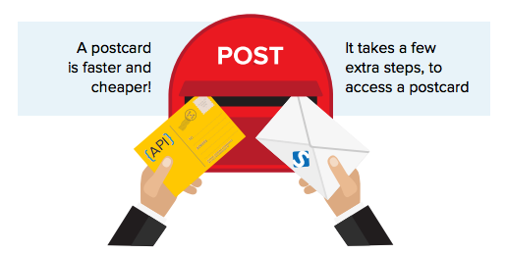
SOAP VS REST
SOAP: (Simple Object Access Protocol) as send mail
More information and complex structure
Cost more bandwidth by XML format
More works for both side provider & consumer
Harder learn for beginner
REST: (Representational State Transfer ) as send postcard
Lighter and faster
Less bandwidth, popular in JSON format
Flexible update
Easy learn

Slide 6
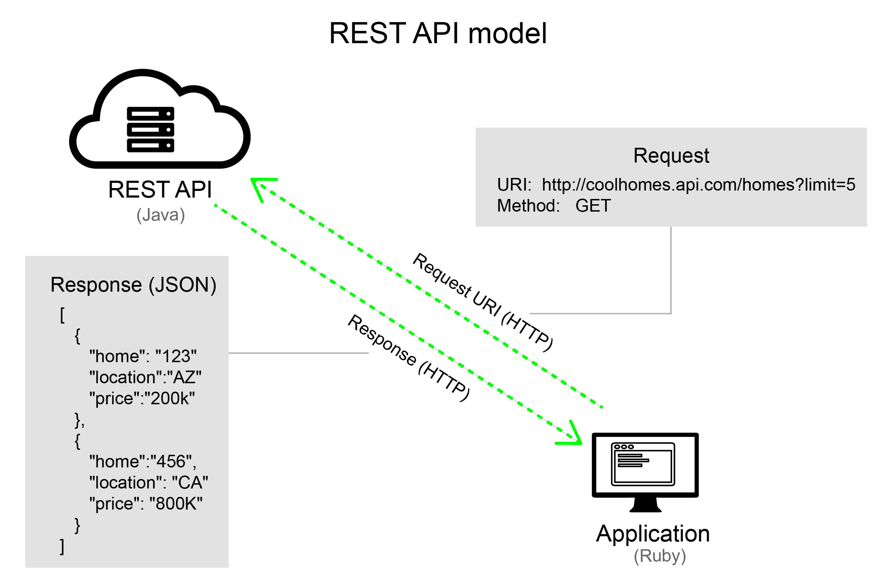
REST API MODEL
URI and HTTP verbs such as GET, POST, PUT, DELETE to access resources
JSON is popular format data in REST

Slide 7
REST with Spring Boot
Spring Framework, Web Application, JSON
Create project: https://start.spring.io
Implement Controller
Start server then Test with Postman

Slide 8
Referals
https://techterms.com/definition/web_service
https://docs.oracle.com/javaee/6/tutorial/doc/gjbji.html
https://labs.tadigital.com/index.php/2018/10/29/web-services-or-web-api/
https://www.soapui.org/learn/api/soap-vs-rest-api/

